Slide 1
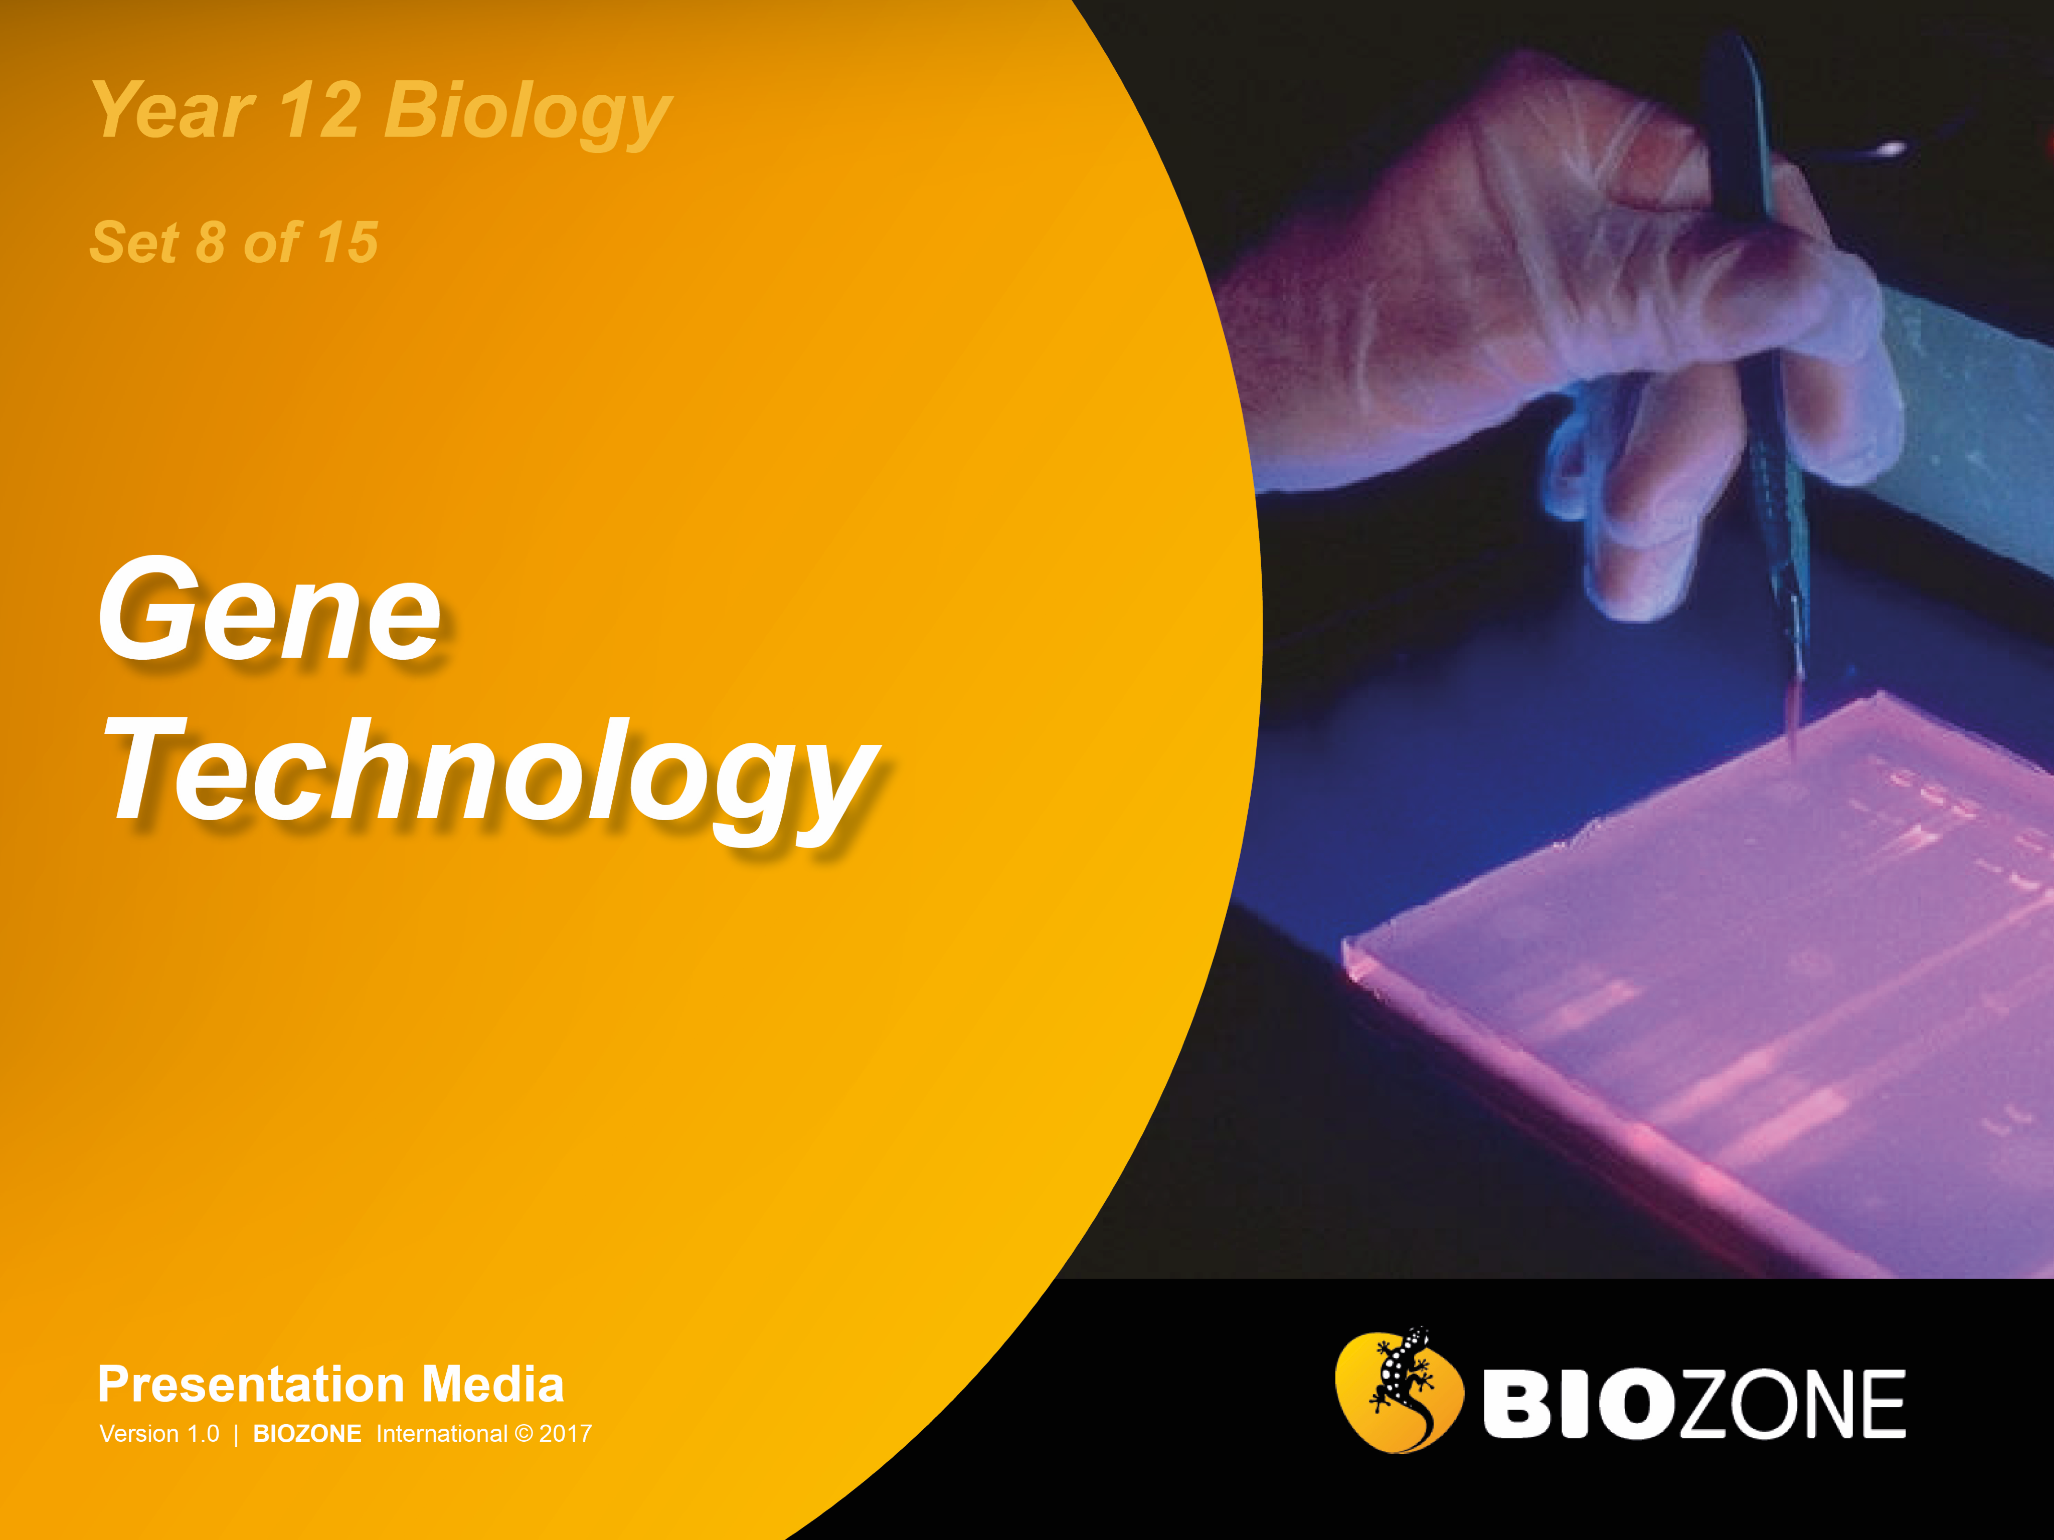

Slide 2
Gene technology
Producing GMOs
Recombinant DNA
Gel electrophoresis
PCR
DNA profiling
DNA sequencing
Human Genome Project
Using recombinant DNA

Slide 3
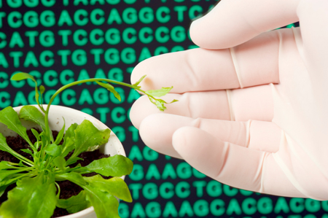
What is Genetic Manipulation?
Genetic manipulation (genetic engineering) involves the direct manipulation of an organism's genome using biotechnology.
This can be achieved by introducing new DNA into an organism or by editing its existing DNA. DNA manipulation aims to produce improved or novel organisms with specific desirable traits.
Organisms that have had their DNA altered are called genetically modified organisms (or GMOs).
iStock

Slide 4
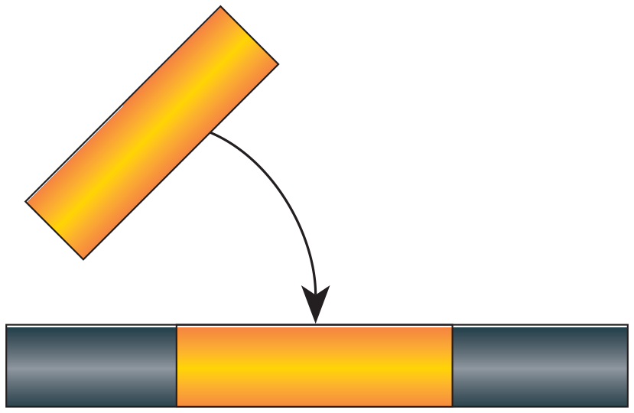


Producing GMOs
Genetically modified organisms (GMOs) may be created by modifying their DNA in one of three ways:
Adding a foreign gene
A foreign gene is added from another species. This will enable the GMO to express the trait encoded by the new gene. Organisms genetically altered in this way are referred to as transgenic.
Host DNA
Alter an existing gene
An existing gene may be altered to make it express at a higher level (e.g. growth hormone) or in a different way (in tissue that would not normally express it). The technique may provide a way to fix a malfunctioning gene.
Existing gene altered
Host DNA
Delete or ‘turn off’ a gene
An existing gene may be deleted or deactivated (switched off) to prevent the expression of a trait (e.g. the deactivation of the ripening gene in tomatoes produced the Flavr-Savr tomato).
Host DNA

Slide 5
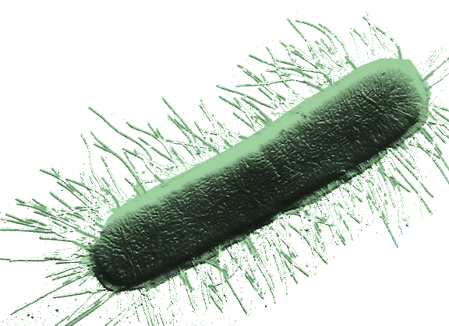
Recombinant DNA
Recombinant DNA (rDNA) is produced by combining genetic material from two or more different sources.
The production of rDNA is possible because the DNA of every organism is made of the same building blocks (nucleotides). rDNA allows a gene from one organism to be moved into, and expressed in, a different organism.
Two important tools are used to create rDNA. Endonucleases (such as restriction enzymes or the CRISPR-Cas9 system) cut the DNA and the enzyme DNA ligase is used to join the sections of DNA together.
The human insulin gene can be inserted into microorganisms such E.coli or Saccharomyces yeast to make human insulin.

Slide 6
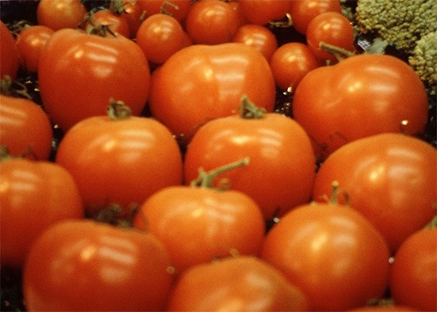
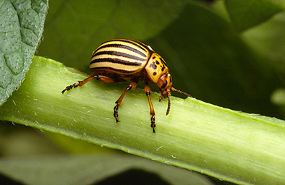
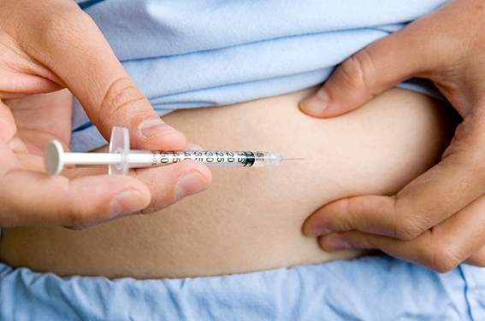
Applications of GMOs
Extending shelf life: Shelf life in fresh produce (e.g. tomatoes) can be extended by switching off the genes for specific enzymes involved in the fruit ripening process (e.g. the enzymes involved in softening of the fruit wall or controlling the production of ethylene).
Pest or herbicide resistance: Plants can be engineered to carry and express genes for insect toxins or herbicide resistance. Pest resistant crops do not require spraying and herbicide resistance allows the grower to control weeds without damaging the crops.
USDA
Biofactories: Transgenic bacteria are widely used to produce desirable commodities, such as hormones or proteins. Large quantities of a product can be produced using bioreactors. One example includes injectable human insulin produced by recombinant bacteria or yeast (right).

Slide 7
Restriction Enzymes
Restriction enzymes are one of the essential tools of genetic engineering. Purified forms of these naturally occurring bacterial enzymes are used as “molecular scalpels”, allowing genetic engineers to cut up DNA in a controlled way.
Restriction enzymes are used to cut DNA molecules at very precise sequences of 4 to 8 base pairs called recognition sites (see below).
By using a ‘tool kit’ of over 400 restriction enzymes recognising about 100 recognition sites, genetic engineers are able to isolate and sequence DNA, and manipulate individual genes derived from any type of organism.
Recognition Site
Recognition Site
The restriction enzyme EcoRI cuts here
cut
GAATTC
GAATTC
DNA
CTTAAG
CTTAAG
cut
cut

Slide 8
Specific Recognition Sites
Restriction enzymes are named according to the bacterial species they were first isolated from, followed by a number to distinguish different enzymes isolated from the same organism.
e.g. BamHI was isolated from the bacteria Bacillus amyloliquefaciens strain H.
A restriction enzyme cuts the double-stranded DNA molecule at its specific recognition site:
Enzyme | Source | Recognition sites
EcoRI | Escherichia coli RY13 | GAATTC
BamHI | Bacillus amyloliquefaciens H | GGATCC
HaeIII | Haemophilus aegyptius | GGCC
HindIII | Haemophilus influenzae Rd | AAGCTT
Hpal | Haemophilus parainfluenzae | GTTAAC
HpaII | Haemophilus parainfluenzae | CCGG
MboI | Moraxella bovis | GATC
NotI | Norcardia otitidis-caviarum | GCGGCCGC
TaqI | Thermus aquaticus | TCGA

Slide 9
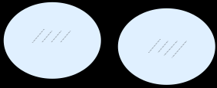
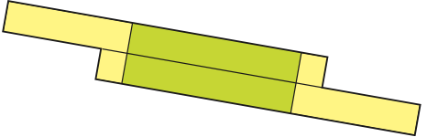
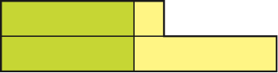

Sticky Ends
Some restriction enzymes cut and leave an overhang. These overhangs are called “sticky ends”.
DNA cut in such a way produces ends which may only be joined to other sticky ends with a complementary base sequence.
See steps 1-3 right:
A restriction enzyme cuts the double-stranded DNA molecule at its specific recognition site.
Restriction enzyme EcoRI
Fragment
G
A A T T C
A A T T C
G
C T T A A
G
G
C T T A A
Restriction enzyme EcoRI
Sticky end
The cuts produce a DNA fragment with two “sticky” ends.
A A T T C
G
The two different fragments cut by the same restriction enzyme have identical sticky ends and are able to join together.
G
C T T A A
DNA from another source
A A T T C
G
A A T T C
G
G
C T T A A
G
C T T A A
When two fragments of DNA cut by the same restriction enzyme come together, they can join by base-pairing.

Slide 10




Blunt Ends
Recognition Site
Recognition Site
Restriction enzyme cuts here
cut
Some restriction enzymes cut leaving no overhang; these are called “blunt ends”.
DNA cut in such a way can be joined to any other blunt end fragment. The joining tends to be non-specific because there are no sticky ends to act as recognition sites.
cut
C C C
G G G
C C C
G G G
DNA
G G G
C C C
G G G
C C C
cut
cut
The cut by this type of restriction enzyme leaves no overhang.
C C C
G G G
C C C
G G G
G G G
C C C
G G G
C C C
G G G
C C C
DNA from another source
C C C
G G G
A special group of enzymes can join the pieces together.
C C C
G G G
C C C
G G G
G G G
C C C
G G G
C C C

Slide 11
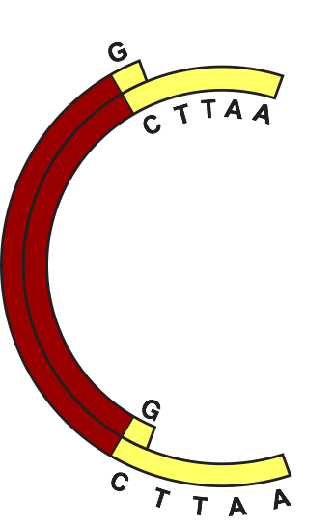

Ligation
DNA fragments produced using restriction enzymes may be reassembled (joined) by a process called ligation.
Pieces of DNA are joined together using an enzyme called DNA ligase.
DNA of different origins joined together in this way is called recombinant DNA because it is DNA that has been recombined from different sources.
Steps 1-3 (below) are involved in creating a recombinant DNA plasmid:
Two pieces of DNA are cut using the same restriction enzyme which produces sticky ends.
This other end of the foreign DNA is attracted to the remaining sticky end of the plasmid.
The two different DNA fragments are attracted to each other by weak hydrogen bonds.
Plasmid DNA fragment
A A T T C
G
G
Foreign DNA fragment
C T T A A

Slide 12
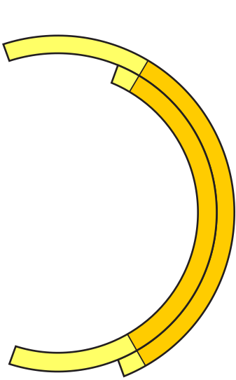

Annealing
When the two matching “sticky ends” come together, they join by base pairing. This process is called annealing.
This can allow DNA fragments from a different source, perhaps a plasmid, to be joined to the DNA fragment.
The joined fragments will usually form either a linear molecule or a circular one, as shown here for a plasmid.
Detail of Restriction Site
A
A
T
T
C
G
Plasmid DNA fragment
Foreign DNA fragment
Restriction sites on the fragments are attracted by base pairing only
Gap in DNA molecule’s ‘backbone’
A
A
T
T
C
G

Slide 13
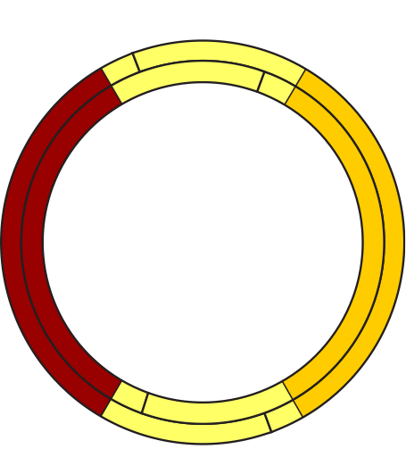
Recombinant DNA Plasmid
The fragments of DNA are joined together by the enzyme DNA ligase, producing a molecule of recombinant DNA.
These combined techniques of using restriction enzymes and ligation are the basic tools of genetic engineering.
DNA ligase
A
A
T
T
Detail of restriction site
G
C
C
T
T
A
A
G
Recombinant plasmid DNA
Fragments linked permanently by DNA ligase
No break in DNA molecule
G
A
A
T
T
C
The fragments are able to join together under the influence of DNA ligase.
C
T
G
T
A
A

Slide 14
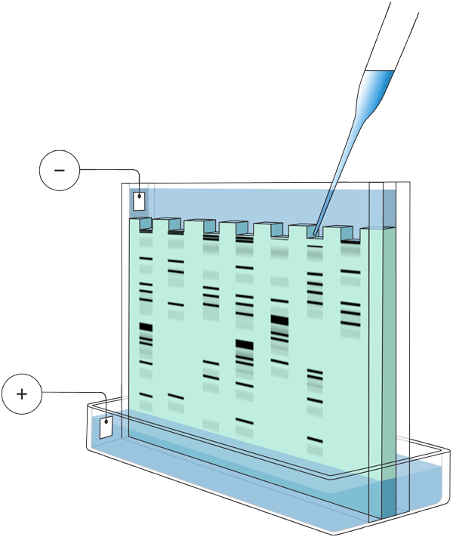
Gel Electrophoresis
Gel electrophoresis can be used to separate large molecules (including nucleic acids or proteins) on the basis of their size, electric charge, and other physical properties.
To prepare DNA for electrophoresis, the DNA is often cut up into smaller pieces. Called a restriction digest, and it produces a range of DNA of different lengths.
To carry out electrophoresis, the DNA samples are placed in wells and covered with a buffer solution that gradually dissolves them into solution.
Wells into which samples to be analysed are placed.
Sample
Cathode
Buffer
Plastic frame
Anode
Gel
DNA fragments, shown symbolically above, move towards the positive terminal (smaller fragments move faster than longer ones).
Buffer solution

Slide 15
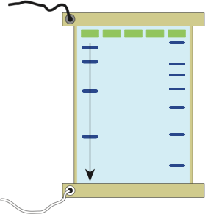
Running the Gel
By applying an electric field to the solution, the molecules move towards one or other electrode depending on the charge on the molecule itself. DNA is negatively charged because the phosphates have a negative charge.
Molecules of different sizes (molecular weights) become separated (spread out) on the gel surface.
These can be visualised as bands by applying dyes or radio-labelled probes.
Wells: Holes created in the gel with a comb.
-ve terminal
DNA solutions: Mixtures of different sizes of DNA fragments are loaded into each well.
Large fragments
DNA markers:
A mixture of DNA molecules with known molecular weights. They are used to estimate the sizes of the DNA fragments in the sample lanes.
DNA fragments: The gel matrix acts as a sieve for the DNA molecules.
Small fragments
+ve terminal
Tray: Contains the set gel.

Slide 16
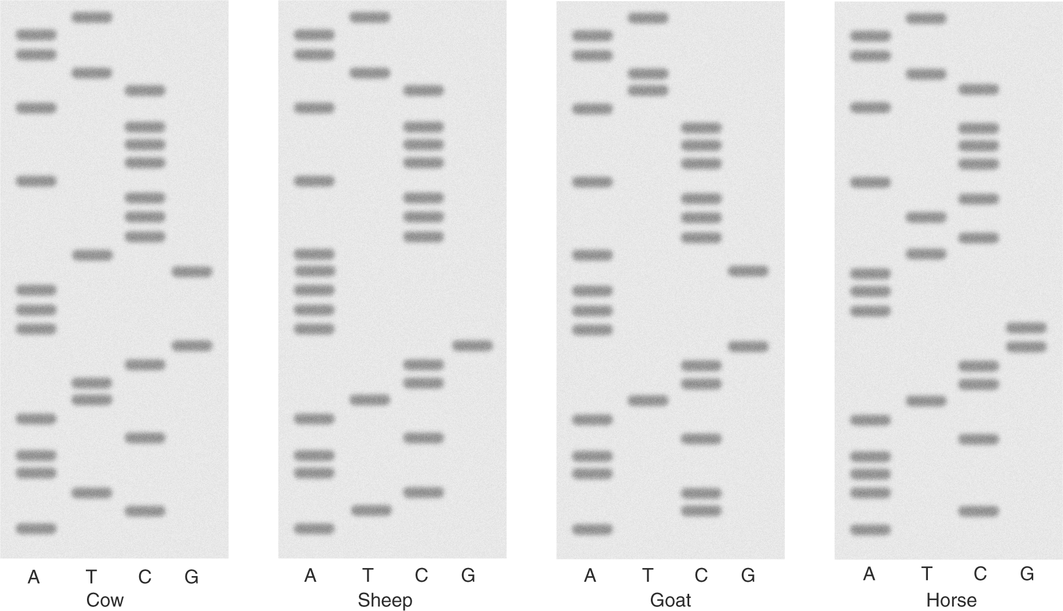
Interpreting Electrophoresis Gels
The banding pattern on an electrophoresis gel can give information about genetic variation and relationships.
Once run, an electrophoresis gel must be interpreted. If a specific DNA base sequence was being investigated, then the band pattern can be used to determine the DNA sequence and the protein that it encoded.
Alternatively, depending on how the original DNA was treated, the banding pattern may be used as a profile for a species or individual.
Commonly, the gene for cytochrome oxidase I (COXI), a mitochondrial protein, is used to distinguish animal species.

Slide 17
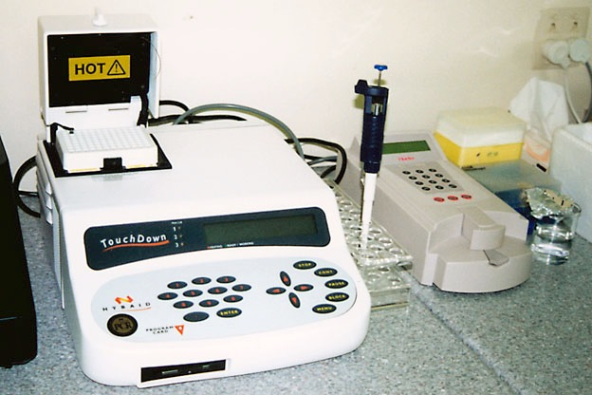
PCR Equipment
Amplification of DNA can be carried out with using PCR machines called thermal cyclers (shown below).
Thermal cyclers are commonly used in the biological research institutes and analytical laboratories.

Slide 18
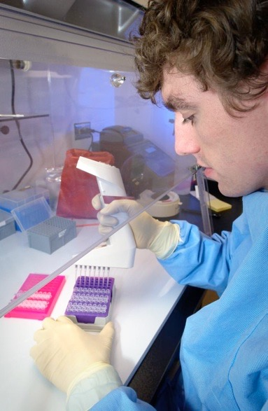
Steps in the PCR Process
The process called the polymerase chain reaction or PCR involves the following steps 1-3 each cycle:
1
Separate strands
Separate the target DNA strands by heating at 98°C for 5 minutes
2
Add reaction mix
Add primers (short nucleotide strands that provide a starting sequence for DNA replication), nucleotides (A, T, G and C) and DNA polymerase enzyme.
Repeat for about 25 cycles
Repeat cycle of heating and cooling until enough copies of the target DNA have been produced.
3
Incubate
Cool to 60°C and incubate for a few minutes. During this time, primers attach to single-stranded DNA. DNA polymerase synthesises complementary strands.

Slide 19


Polymerase Chain Reaction
PCR cycles | No. of target DNA strands
1 | 2
2 | 4
3 | 8
4 | 16
5 | 32
6 | 64
7 | 128
8 | 256
9 | 512
10 | 1024
11 | 2048
12 | 4096
13 | 8192
14 | 16,384
15 | 32,768
16 | 65,536
17 | 131,072
18 | 262,144
19 | 524,288
20 | 1,048,576
21 | 2,097,152
22 | 4,194,304
23 | 8,388,608
24 | 16,777,216
25 | 33,554,432
Although only three cycles of replication are shown here, following cycles replicate DNA at an exponential rate and can make millions of copies in only a few hours.
The process of PCR is detailed in the following slide sequence of steps 1-5.
Original DNA
Sample
Cycle 1
Cycle 2
Cycle 3

Slide 20
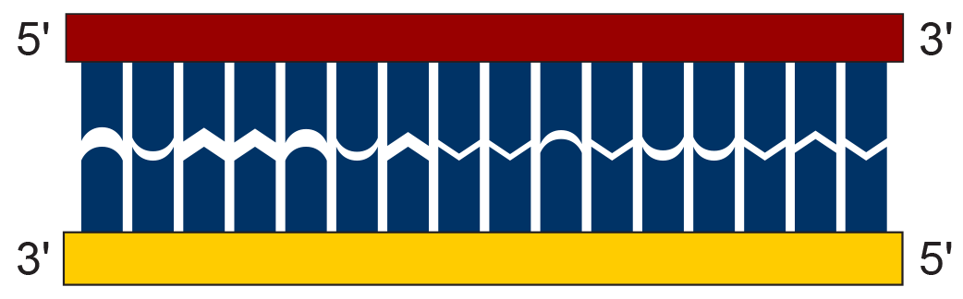


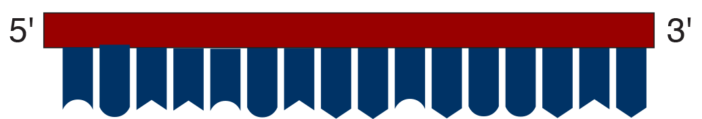


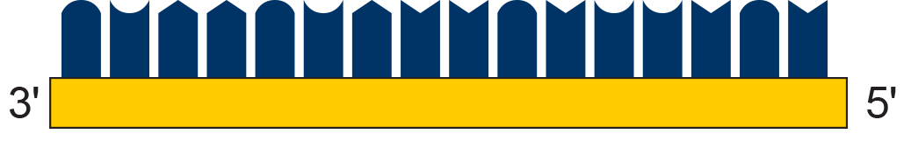
The Process of PCR
1
A DNA sample called the target DNA is obtained.
2
DNA is denatured (DNA strands are separated) by heating the sample for 5 minutes at 98ºC.
3
Primers (short strands of nucleotides) are annealed (bonded) to the DNA.
Primer annealed
Primer moving into position

Slide 21




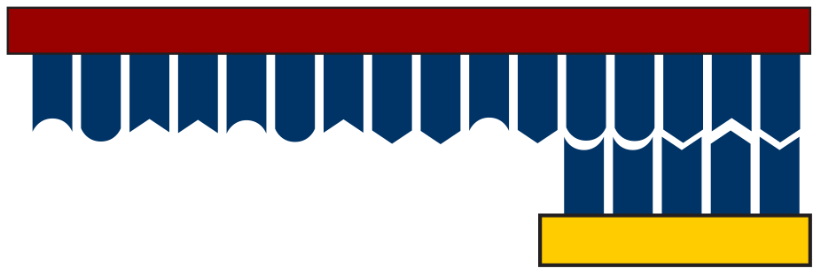
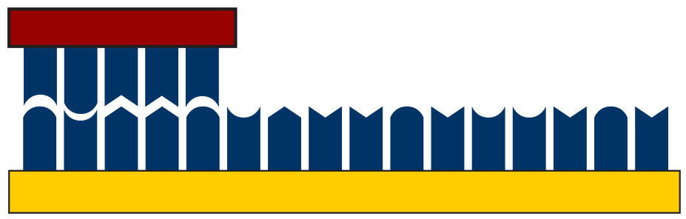




The Process of PCR
Nucleotides
4
The sample is cooled to 60°C. A thermally stable DNA polymerase enzyme binds to the primers on each side of the exposed DNA strand.
This enzyme synthesises a complementary strand of DNA using free nucleotides.
Direction of synthesis
Direction of synthesis
Nucleotides
5
After one cycle, there are now two copies of the original sample.

Slide 22
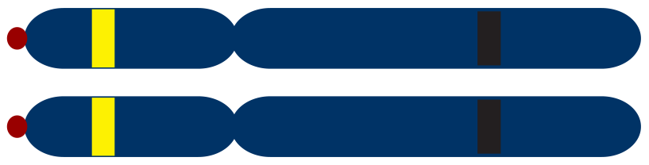
DNA Profiling Using PCR
Microsatellites or short tandem repeats (STRs) are found throughout the genome within genes and between genes, particularly near telomeres and centromeres.
Microsatellites consist of a variable number of tandem repeats of a 2 to 6 base pair sequence. In the example shown it is a two base sequence (CA) that is repeated.
The human genome contains about 100,000 separate blocks of tandem repeats of the dinucleotide: CA. One such block at a known location on a chromosome is shown in the diagram opposite.
Microsatellite containing 4 repeat units
Homologous pair of chromosomes
telomeres
centromeres
Microsatellite containing 7 repeat units
Flanking regions to which PCR primers can be attached

Slide 23
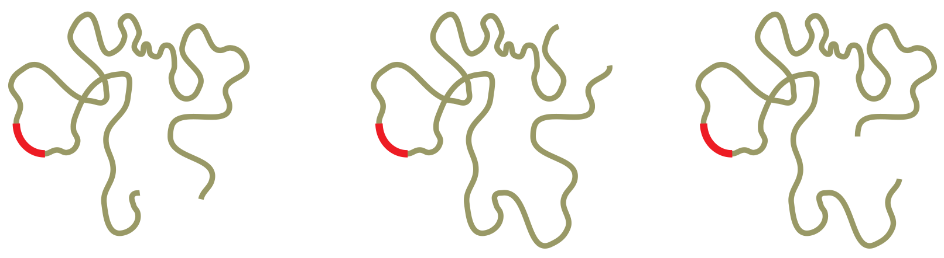
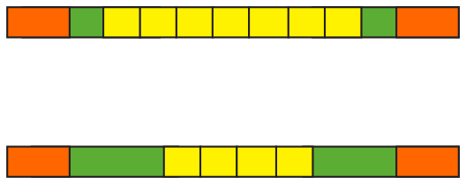
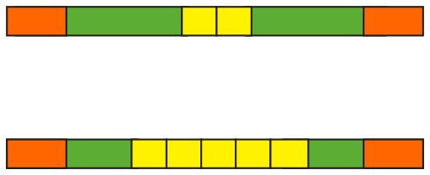
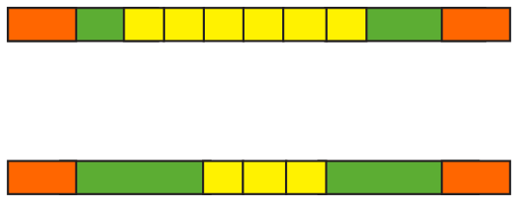
STRs Used in DNA Profiling
1
Extract DNA from sample
A sample is collected from the tissue of three individuals from which the DNA is extracted, separated and purified.
DNA from
individual ‘A’:
DNA from
individual ‘B’:
DNA from
individual ‘C’:
Microsatellite
2
Amplify microsatellite using PCR
Specific primers (arrowed and orange) attach to the flanking regions (green) either side of the microsatellite (yellow).
They are used to make large quantities of the microsatellite and flanking regions sequence only (no other part of the DNA is amplified).
DNA
Microsatellites from
Individual ‘A’
Microsatellites from
Individual ‘B’
Microsatellites from
Individual ‘C’

Slide 24
PCR and Electrophoresis
7
2
6
4
5
3
The results of PCR are many fragments
A
B
C
Largest fragments
3
Visualise fragments on a gel
The fragments are separated by length using gel electrophoresis. DNA, which is negatively charged, moves towards the positive terminal. The smaller fragments travel faster than the larger ones.
7
6
5
4
3
2
Smallest fragments

Slide 25
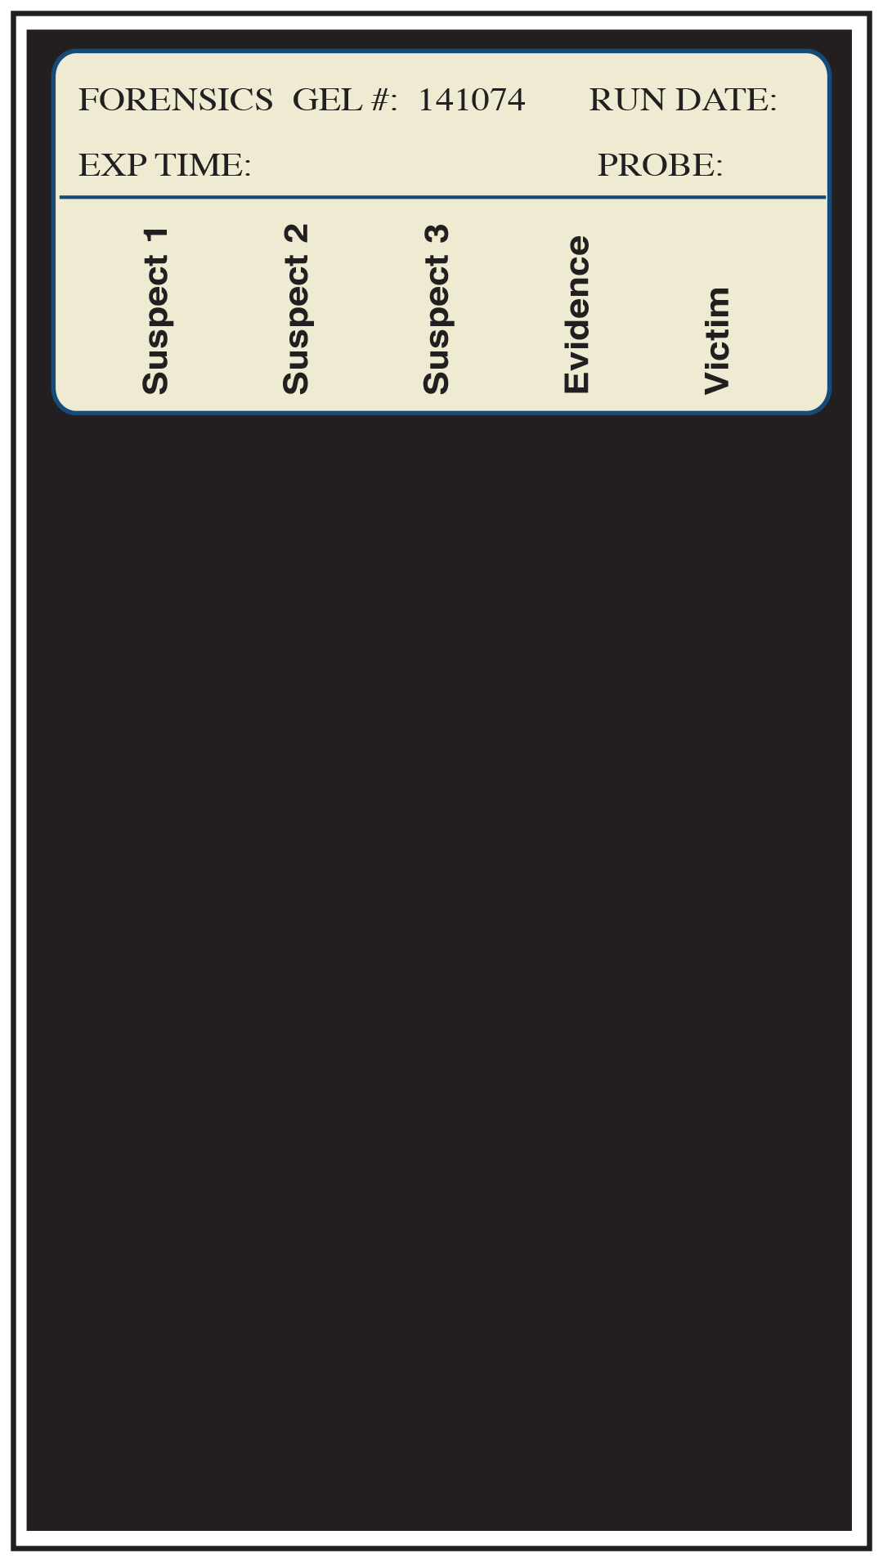
Forensic DNA Evidence
DNA fingerprints from tissue samples can be used as evidence in the same way traditional fingerprinting is used.
DNA is isolated from samples at the crime scene. Samples from the victim are also taken to eliminate them as a possible source of contamination.
DNA profiles are run and the results can be compared against a DNA database of convicted offenders.
Which DNA fingerprint from the three suspects matches that of the tissue sample submitted as evidence?

Slide 26
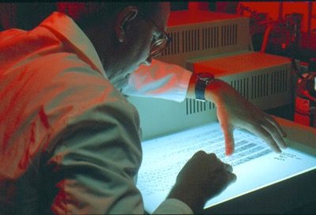
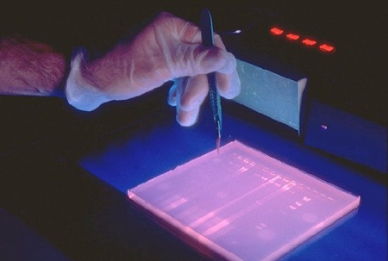
DNA Profiling
DNA profiling (DNA fingerprinting) is a technique for genetic analysis, which identifies the variations found in the DNA of every individual.
The profile refers to the distinctive pattern of DNA restriction fragments or PCR products which is used to identify an individual.
There are different methods of DNA profiling, each with benefits and drawbacks.
DNA profiling does not determine a base sequence for a sample but merely sorts variations in base sequences.
Only one in a billion (i.e. a thousand million) people are likely to have an identical DNA profile to someone else, making DNA profiling a useful tool for forensic investigations and paternity analysis.
CDC
CDC

Slide 27
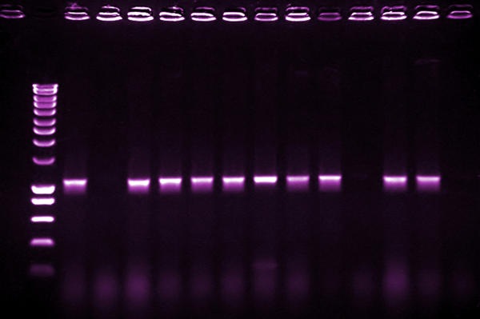
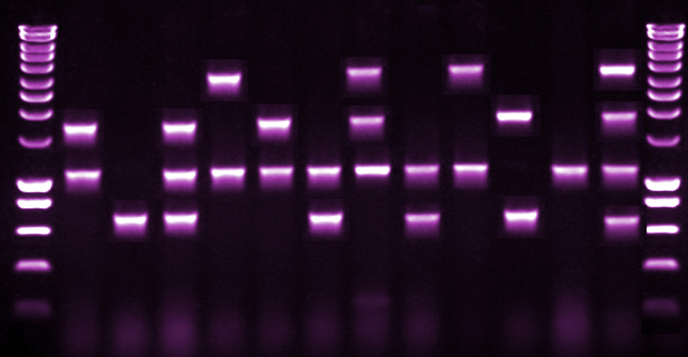
DNA Profiling Methods
DNA fragments can be visualised under UV light after staining with ethidium bromide and migration in an agarose electrophoresis gel.
iStock

Slide 28
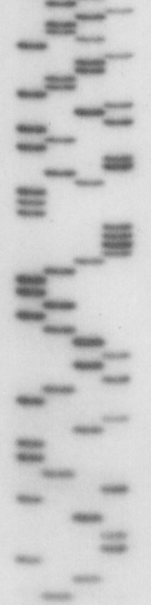
DNA Profiling Methods
DNA profiling begins by extracting DNA from the cells in a sample of blood, saliva, semen, or other fluid or tissue.
Two methods are commonly used. Both are based on the analysis of short repetitive sequences in the DNA.
Profiling using probes (RFLP analysis) was the first profiling technique to be developed. Restriction enzymes are applied to a DNA sample and the DNA fragments are separated on a gel. Radioactive probes are used to label DNA fragments with complementary sequences.
Profiling using PCR is a newer technique which uses highly polymorphic regions of DNA that have short repeated sequences of DNA. These sequences are amplified using PCR and then separated on a gel.
This technique is suitable when there is very little DNA available or the sample is old.

Slide 29
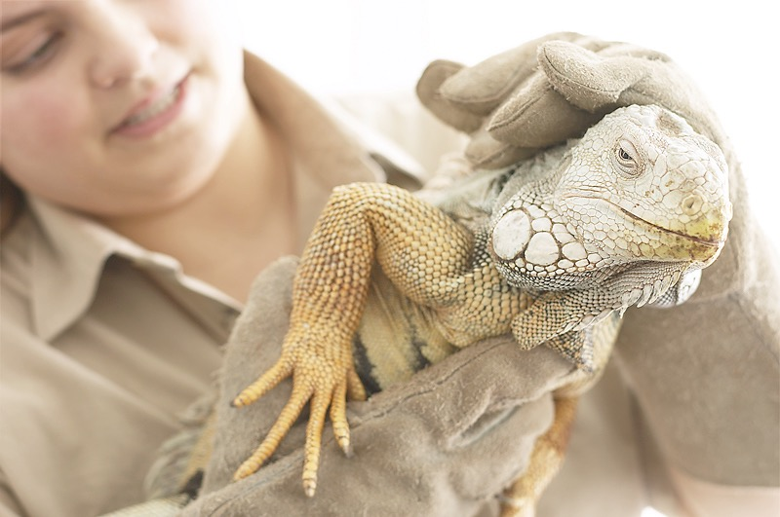
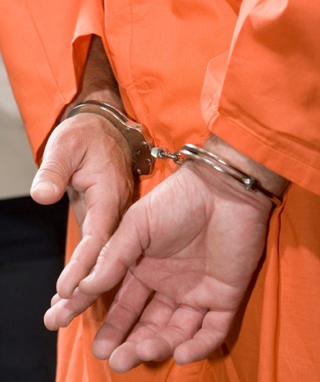
Uses of DNA Profiling
DNA profiling can be used for investigating:
parentage
forensic investigations
the presence of a particular gene
genetic relatedness of different organisms
e.g. checking on pedigree in stock breeding programs.
e.g. checking that captive populations of endangered species are not inbred.
AT
iStock

Slide 30
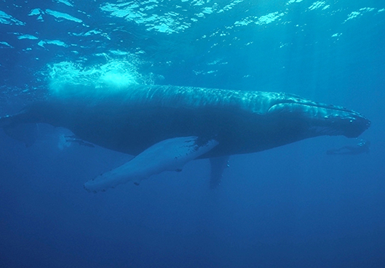
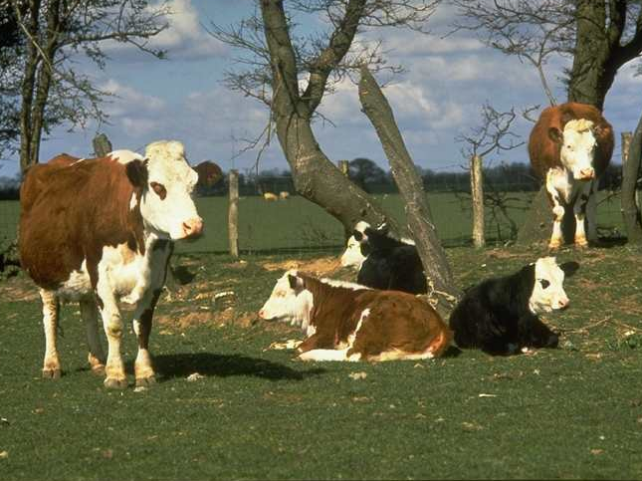
A Whale of a Tale
Whaling is a controversial practice. Many nations are opposed to it while others claim it to be an historic right.
In many countries selling whale meat is illegal or only legal or some species and only under strict rules.
Between 1999 and 2003 Scott Baker and associates from Oregon State University's Marine Mammal Institute investigated whale meat sold in markets in Japan and South Korea.
Using DNA profiling techniques, they found around 10% of the samples tested were from fully protected whales including western grey whales and humpbacks.
They also found that many more whales were being killed than were being officially reported.
In 2010 Scott Baker’s team used the same method to show a top restaurant in Santa Monica was selling whale meat (where such practice is strictly illegal).
The restaurant was also selling horse meat that actually turned out to be beef.
Those aren’t horses.

Slide 31
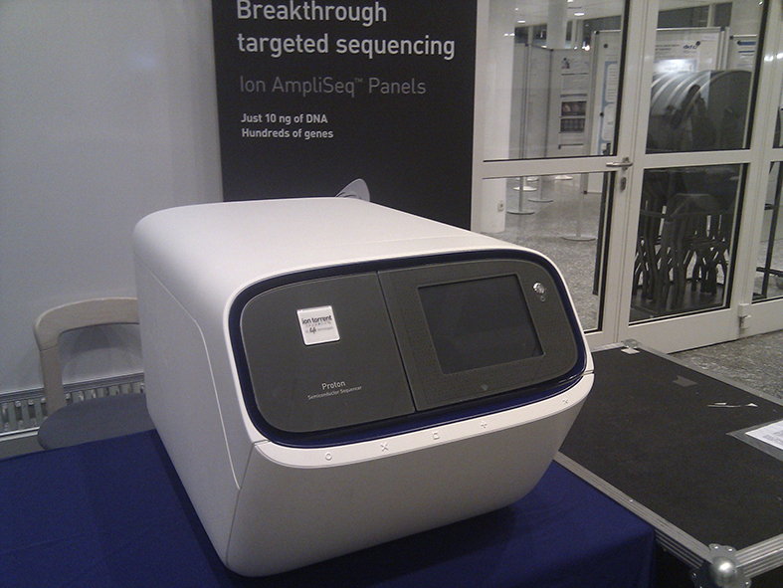
Automated DNA Sequencing
The process of DNA sequencing can be automated. Every year faster, smaller, and more accurate machines are produced.
DNA sequencing is many orders a magnitude faster today than a decade ago.
Today’s DNA sequencers need only a small amount of DNA to produce a sequence.
High throughput, next generation (NextGen) sequencers read the DNA as it is being copied, a technique called sequencing by synthesis.
As each nucleotide is added to the DNA a digital camera reads a fluorescent tag attached to the nucleotide. Thousands to millions of sequences can be read at once, allowing million to billions of DNA fragments to be sequenced at the same time.
The resulting sequences are compared by computer and aligned based on overlapping sequences. Next generation sequencers have dramatically improved the feasibility and reduced the costs of whole genome sequencing.
Konrad Förstner
The Ion Proton semiconductor sequencer uses a semiconductor to detect the hydrogen ions given off when nucleotides bind to a growing DNA molecule.

Slide 32
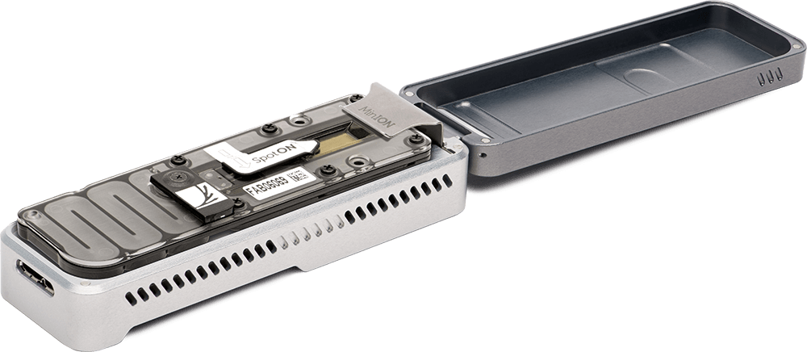
Nanopore Technology
In nanopore sequencing a DNA strand is manipulated to pass though an 8 mm wide pore in a synthetic membrane.
This is done either by electrophoresis or by use of an enzyme.
A voltage across the membrane produces a current through the nanopore.
As each base of the DNA passes through the pore it interrupts the current in a characteristic way.
This type of third generation sequencing technology is now small enough to fit on a chip/reader that is little bigger than a USB memory stick and can read about 150 million base pairs per run.
Oxford Nanopore Technologies.
The MinION, developed by Oxford Nanopore Technologies. It weighs under 100 g and plugs into a PC or laptop using a USB 3.0 cable

Slide 33
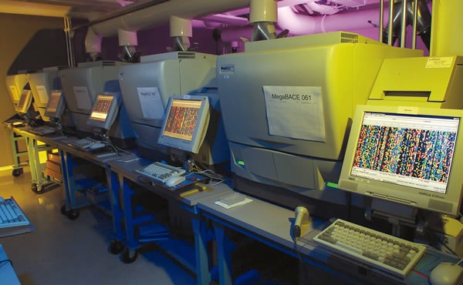
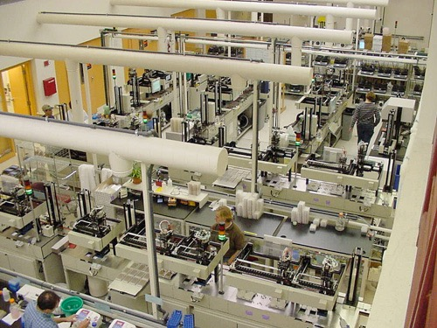
Human Genome Project
The Human Genome Project (HGP) was a venture involving over 1000 scientists from 50 countries around the world to sequence the human genome.
Production Sequencing Facility at DOE's Joint Genome Institute in Walnut Creek, California, USA. Photo: U.S. Department of Energy Joint Genome Institute, http://www.jgi.doe.gov.
Photo of Large-Scale Sequencing Center, view from top. Courtesy: The Broad Institute of MIT and Harvard

Slide 34
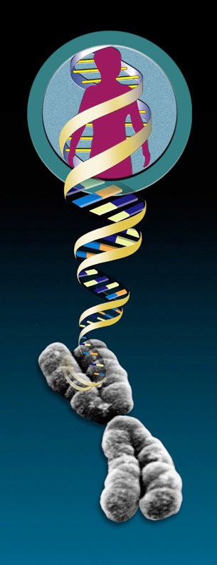
HGP Goals
Project goals were to:
Identify all the approximately 20,000-25,000 protein-coding genes in human DNA.
Determine the sequences of the 3 billion chemical base pairs that make up human DNA.
Store this information in databases.
Improve tools for data analysis.
Transfer related technologies to the private sector.
Address the ethical, legal, and social issues that may arise from the project.

Slide 35
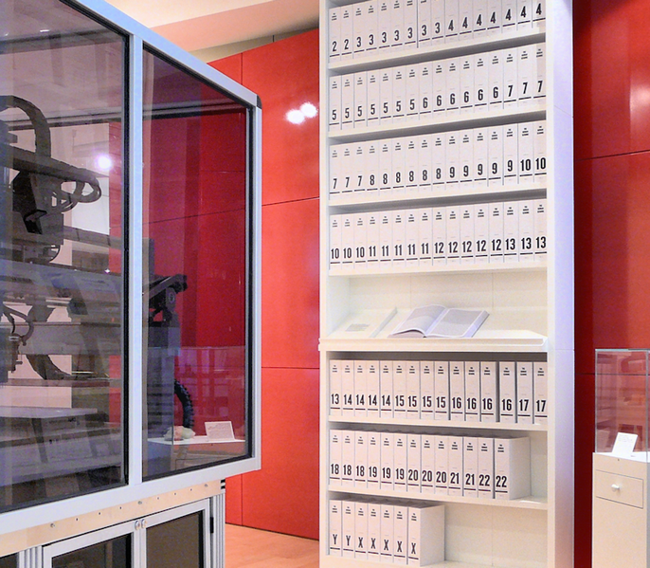
Human Genome Project
The HGP project was declared complete in 2003.
It sequences 92% of the nuclear DNA in human cells to 99.99% accuracy.
The unsequenced DNA is found in centromeres and telomeres.
Research into the DNA sequences is on going.
Russ London CC 3.0
A printout of the human DNA sequence per chromosome.

Slide 36
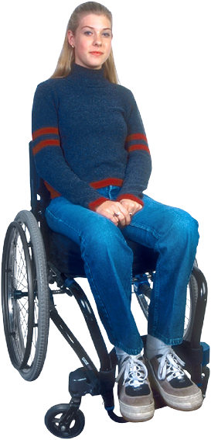
Benefits of the HGP
It is hoped that mapping the human genome will lead to a complete understanding of the genetic basis of humans as well as the source of nearly 4000 known genetic disorders.
Genes already identified as leading to disease include Huntington’s disease, cystic fibrosis, the most common form of skin cancer, and breast cancer.
Mapping and sequencing of all human genes will allow:
Development of a new therapeutic drugs.
Production of virtually any human protein.
Design of new molecules to specifically block metabolic pathways that lead to disease.
Development of gene therapy procedures for all genetically determined diseases (recently devised for Huntington’s Disease).

Slide 37


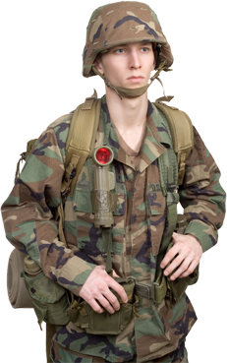
HGP Bioethics
Societal concerns arising from the HGP:
Fairness in the use of genetic information by insurers, employers, courts, schools, adoption agencies, and the military, among others.
Who should have access to personal genetic information, and how will it be used?
Privacy and confidentiality of genetic information.
Who owns and controls genetic information?
Psychological impact and stigmatisation due to an individual's genetic differences.
How does personal genetic information affect an individual and society's perceptions of that individual?
How does genomic information affect members of minority communities?
Source: http://www.ornl.gov/sci/techresources/Human_Genome/elsi/elsi.shtml

Slide 38
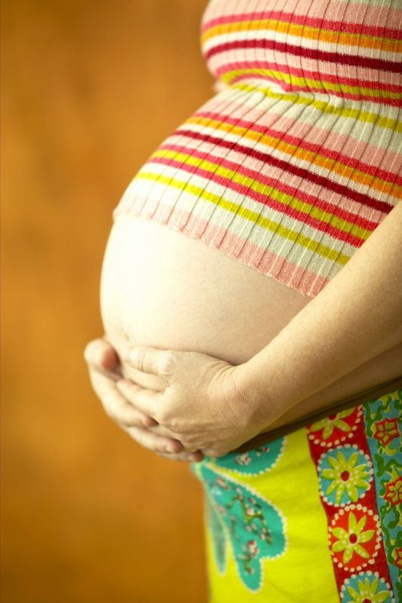
HGP Bioethics
Societal concerns arising from the HGP:
Reproductive issues including adequate informed consent for complex and potentially controversial procedures, use of genetic information in reproductive decision making, and reproductive rights.
Do healthcare personnel properly counsel parents about the risks and limitations of genetic technology?
How reliable and useful is fetal genetic testing?
What are the larger societal issues raised by new reproductive technologies?
Source: http://www.ornl.gov/sci/techresources/Human_Genome/elsi/elsi.shtml

Slide 39

HGP Bioethics
Societal concerns arising from the HGP:
Clinical issues including the education of doctors and other health service providers, patients, and the general public in genetic capabilities, scientific limitations, and social risks.
Implementation of standards and quality-control measures in testing procedures.
How will genetic tests be evaluated and regulated for accuracy, reliability, and utility?
How do we prepare healthcare professionals for the new genetics?
How do we prepare the public to make informed choices?
How do we as a society balance current scientific limitations and social risk with long-term benefits?
Source: http://www.ornl.gov/sci/techresources/Human_Genome/elsi/elsi.shtml

Slide 40

HGP Bioethics
Societal concerns arising from the HGP:
Uncertainties associated with gene tests for susceptibilities and complex conditions (e.g. heart disease) linked to multiple genes and gene-environment interactions.
Should testing be performed when no treatment is available?
Should parents have the right to have their minor children tested for adult-onset diseases?
Are genetic tests reliable and interpretable by the medical community?
Source: http://www.ornl.gov/sci/techresources/Human_Genome/elsi/elsi.shtml

Slide 41
Preparing a Gene For Cloning
One problem with cloning DNA directly from an organism’s cell is that it often contains long non-coding regions called introns.
These introns can be of enormous length and cause problems when the gene as a whole is inserted into plasmids or viral DNA vectors for cloning:
Plasmids tend to lose large inserts of foreign DNA.
Viruses cannot fit the very long DNA into their protein coats (capsids).
To avoid these problems, it is possible to make an artificial gene that lacks introns.
This is possible by using an enzyme called reverse transcriptase which is able to reverse the process of transcription by making DNA molecules out of their mRNA products.
The important feature of this process is that mRNA has already had the introns removed. By using mRNA as the template to recreate the gene, the DNA will also lack the troublesome intron regions.

Slide 42

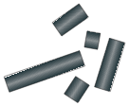
Producing an Artificial Gene
1
Double stranded DNA of a gene from a eukaryotic organism (e.g. human) containing introns.
Double stranded molecule of genomic DNA
Using an enzyme called reverse transcriptase, it is possible to create an artificial gene that lacks introns.
Steps 1-3 in the diagram opposite illustrate the normal process of transcription in the cell, and steps 4-6 on the following slide show how scientists are able to make the artificial gene.
DNA
Intron
Intron
Intron
Intron
Intron
Exon
Exon
Exon
Exon
Exon
Exon
2
As a normal part of the cell process of gene expression, transcription creates a primary RNA molecule.
Transcription
Primary RNA
3
The introns are removed by splicing enzymes to form a mature mRNA (now excluding the introns) that codes for a single protein.
Introns are removed
Exons are spliced together
Introns
mRNA

Slide 43


Producing an Artificial Gene
4
The mRNA is extracted from the cell and purified
mRNA
5
Reverse transcriptase is added which synthesises a single stranded DNA molecule complementary to the mRNA
mRNA
Reverse Transcription
DNA
6
The second DNA strand is made by using the first as a template, and adding the enzyme DNA polymerase
DNA strand being synthesised by reverse transcriptase
DNA
Completed artificial gene consisting of a double stranded molecule of complementary DNA (cDNA)
DNA

Slide 44
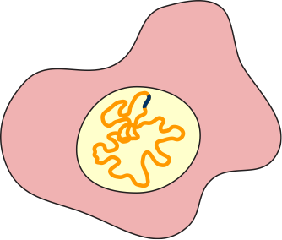
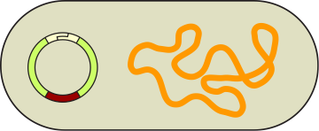






Using Plasmids
Preparing a molecular clone
Escherichia coli bacterial cell
Human cell
Human gene
Plasmid
Chromosome
DNA in chromosome
Sticky end
Sticky end
Plasmid vectors, found in bacteria, are prepared for cloning following steps 1-6:
Restriction enzyme recognition sequence
1
A gene of interest (DNA fragment) is isolated from human tissue cells.
Plasmid
vector
Ampicillin-resistance gene
Tetracycline-resistance gene
3
Human DNA and plasmid are treated with the same restriction enzyme to produce identical sticky ends.
Gene disrupted
2
An appropriate plasmid vector is isolated from a bacterial cell.
4
Restriction enzyme cuts the plasmid DNA at its single recognition sequence, disrupting the tetracycline resistance gene.
Sticky ends
5
Mix the DNAs together and add the enzyme DNA ligase to join the sticky ends.
Recombinant DNA
molecule
Human gene
6
Recombinant plasmid (a molecular clone) is introduced into a bacterial cell by adding the DNA to a bacterial culture where some bacteria take up the plasmid from solution.

Slide 45



Cloning a Gene
Once inserted in a bacteria the gene can be cloned as the plasmid is replicated when the bacteria divides.
Colonies of bacteria that carry the recombinant plasmid can be identified by differential response to antibiotics (e.g. resistant to ampicillin but sensitive to tetracycline).
An alternative to using tetracycline sensitivity is by splicing in the gene for Green Florescent Protein (GFP) which glows green under UV light along with the target gene.
Bacterium
Bacteria containing the recombinant plasmid are spread onto an agar plate containing ampicillin.
Human gene
Recombinant plasmid
All colonies look identical but only some have the plasmid with the human gene.
Agar containing ampicillin allows only bacterial colonies with the appropriate plasmid containing the Ampicillin-resistance gene to grow.
Dish A
Filter paper is pressed against the agar plate thereby transferring colonies of bacteria to the paper.
Filter paper
The filter paper is pressed against agar that contains tetracycline. Those colonies that grow do not have the human gene disrupting the tetracycline resistance gene.
Dish B
Colonies with the human gene can be located according to their position on the original dish A.

Slide 46






Using Bacteria to Make Chymosin
Splicing a new gene into a bacteria allows the bacteria to make the protein product of that gene.
Chymosin is an enzyme used in the production of cheese.
Traditionally is was taken from the stomachs of calves.
However a more economic and humane way of producing the enzyme is to splice the gene into bacteria.
The bacteria are then grown in vats and produce the chymosin enzyme.
The enzyme can then be extracted in large quantities.
Plasmid isolated from E. coli bacteria
Chymosin gene isolated from calf DNA
Chymosin gene spliced into plasmid
Chymosin is produced by the bacteria

Slide 47





Using Bacteria to Produce Insulin
Type I diabetes mellitus is a metabolic disease caused by a lack of insulin.
It is treatable only with insulin injections.
In the past insulin was taken from the pancreases of cows and pigs and then refined for human use.
This method was expensive and caused a number of side effects.
One method of mass producing insulin is to splice the gene into bacteria.
However, due to their size, the two chains that make up insulin must be made in separate bacteria and then combined once extracted.
The gene sequence for insulin chain A is spliced into plasmid and inserted into a bacterium.
The gene sequence for insulin chain B is spliced into plasmid and inserted into a different bacterium.
The two protein chains are combined in a separate reaction

Slide 48


Using Yeast to Produce Insulin
Saccharomyces
The yeast Saccharomyces is also used to produce insulin.
The yeast cell is much larger and can accommodate a much larger plasmid.
This means the entire insulin gene can be spliced into a plasmid and inserted into the yeast.
The complete insulin product is then produced by the yeast, saving the need to combine the chains in a separate reaction.
Because the yeast is a eukaryote, less refining of the protein product is needed.
Disulfide bond
Disulfide bond
Insulin is produced as one long chain and cleaved in two places. The separated chains are then held together by the formation of disulfide bonds

Slide 49



Golden Rice
The production of golden rice was a milestone in genetic engineering. It was the first time a new metabolic pathway had been created by splicing new genes into an organisms DNA.
Rice produces β-carotene (a precursor for vitamin A) in its leaves but not in the rice grain. Scientists were able to switch on a pathway that enabled the rice to produce and store β-carotene in the rice grain.
This would boost the amount of β-carotene received by people who eat rice as a staple and thus allow their bodies better access to vitamin A.
Vitamin A is involved in many functions including vision, immunity, fetal development, and skin health.
The PSY gene was extracted from the daffodil
The CRT1 gene was extracted from the bacteria Erwinia uredovora
The two genes were spliced into Agrobacterium, which was used to infect rice plant embryos.
Ordinary rice
Golden rice
IRRI

Slide 50


The Benefits of Genetic Modification
Genetically modified organisms (GMOs) have many potential benefits, but their use raises a number of biological and ethical concerns.
Potential benefits include:
Increase in crop yields, including crops with more nutritional value and that store for longer.
Decrease in the use of pesticides, herbicides and animal remedies.
Production of crops that are drought tolerant or salt tolerant.
Improvement in the health of the human population and the medicines used to achieve it.
Development of animal factories for the production of proteins used in manufacturing, the food industry, and health.
DPC
DPC

Slide 51


The Risks of Genetic Modification
Potential risks associated with genetic modification include:
Possible (uncontrollable) spread of transgenes into other species of plants, or animals.
Concerns that the release of GMOs into the environment may be irreversible.
Animal welfare and ethical issues: GM animals may suffer poor health and reduced life span.
GMOs may lead to the emergence of pest, insect, or microbial resistance to traditional control methods.
May create a monopoly and dependence of developing countries on companies who are seeking to control the world’s commercial seed supply.
USDA
Greenpeace

Slide 52


Slide 53
Conditions of Use
NOTE: Presentation Media = presentations available on CD-ROM/DVD-ROM or as downloads
BIOZONE retains copyright to the intellectual property included in the Presentation Media files, with acknowledgement that certain photos are used under license and are credited appropriately.
You MAY:
Use the Presentation Media files for presentations in your classrooms using a data projector, interactive whiteboard or overhead projector.
Place the Presentation Media files on any staff computer within the school, including staff laptops, but not in contradiction to clause (g).
Place the Presentation Media files on:
The school’s intranet (school computer network)
VLE (Virtual Learning Environment)
A CMS (Content Management System).
Student and staff access must be restricted to those who are enrolled/working on the campus of the registered purchaser. Student and staff access to a VLE or a CMS must be controlled by a user login and password protocol, but not in contradiction to clause (f). If students have access, they need to be made aware of the Conditions of Use and are only allowed to view the content.
Edit and customise the Presentation Media files by adding, deleting, and modifying information to better suit your needs, but not in contradiction to clauses 2 (c) - (d).
Print out the Presentation Media files in PowerPoint® or Keynote® “Handouts” mode for the express purpose of allowing students to make their own notes about the presentation, but not in contradiction to clause (e).
You MAY NOT:
Place the Presentation Media files on to the Internet or on a service that may be accessed off-campus unless access to the service is protected by a user login and password protocol, and is restricted to students and staff enrolled/working on the campus of the registered purchaser.
Place the Presentation Media files on student laptop computers.
REMOVE any of the references to BIOZONE, the title slides, copyright notices, photo credits, or Conditions of Use from the Presentation Media files.
Create a NEW document using any of the graphics/images in the Presentation Media files.
Print the Presentation Media files on to paper to make your own worksheets for distribution to students.
Incorporate any part of the Presentation Media files for the production of another commercial product.
Share or give away any content off-campus. This prohibition apples to, but is not limited to, sharing via the Internet or any website, (examples: YouTube, slide sharing websites).
Conditions of Use are subject to change without notice. Visit http://www.biozone.com.au/faqconditionsofuse/

Slide 54
Photo Credits
Photographic images are used under license from the following commercial photo libraries:
Corel Corporation Professional Photos (uncoded)
ArtToday.com (coded AT)
Clipart.com (coded CA)
PhotoObjects.com (coded PO)
iStock.com (coded iStock)
Hemera Technologies Inc. (coded Hemera)
Photos.com (coded PC)
Education interactive (coded EII)
Digital Stock (coded DS)
LifeArt (coded LA)
Dollar Photo Club (coded DPC)
3D models were created using Poser
Additional artwork and photographs are the property of BIOZONE International Ltd. All rights reserved.
Some 2D artwork has been adapted from TechPool STUDIOS LifeArt Collections, used under licence.
Images from the Public Domain: Where these licenses have been used, authors and licenses have been acknowledged alongside their image.
Centers for Disease Control (coded CDC)
National Institutes of Health (coded NIH)
National Aeronautics and Space Administration (NASA)
U.S. Department of Agriculture (coded USDA)
Images from the public domain include limited copyright, copyright expired, uncopyrighted, or uncopyrightable material:
Licenses including: GNU Free Documentation License http://www.gnu.org/copyleft/fdl.html
Creative Commons Attribution Share Alike http://creativecommons.org/licenses/by-sa/3.0/
Wikimedia Commons
NOTE: Where images are edited or moved from or within this file, the accompanying photo credit must be retained.

Slide 55


